Slide 1
Winter Water Prep Meeting
October 16, 2020

Slide 2
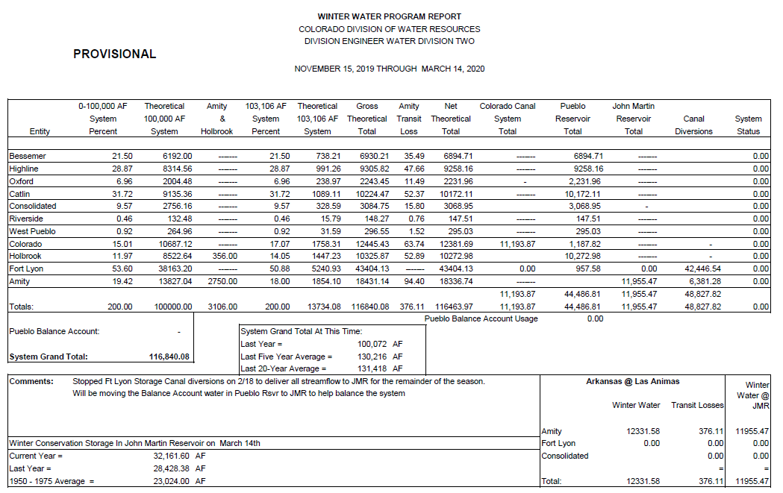
Last Year’s Ending Totals

Slide 3
19 / 20 Timeline and Actions
Ft Lyon started diverting on November 16 and continued through February 19
Colorado Canal started diverting on November 16 and continued through December 10
There were no diversions to the Holbrook nor Great Plains
The river through Pueblo maintained 100 cfs through the season

Slide 4
Shortfall in John Martin Reservoir
We had trouble getting enough water to JMR resulting in Amity having all the storage in JMR and still had to have 6,381 a/f in Adobe Reservoir.
That was even with the Ft Lyon stopping on February 19th.
Storage in JMR:
Nov 16 – Nov 30 934.15 a/f
Dec 1 – Dec 15 750.82 a/f
Dec 16 – Dec 31 663.78 a/f
Jan 1 – Jan 15 652.90 a/f
Jan 16 – Jan 31 545.80 a/f
Feb 1 – Feb 15 529.26 a/f
Feb 16 – Feb 29 2,649 a/f
Mar 1 – Mar 15 5,229.85 a/f

Slide 5
Historical Storage

Slide 6
Current WW Carryover Balances in Pueblo Reservoir
Colorado Canal 760 a/f
Consolidated 146 a/f
Highline 1,778 a/f
Oxford 231 a/f
Riverside 40 a/f
Total 2,955 a/f

Slide 7
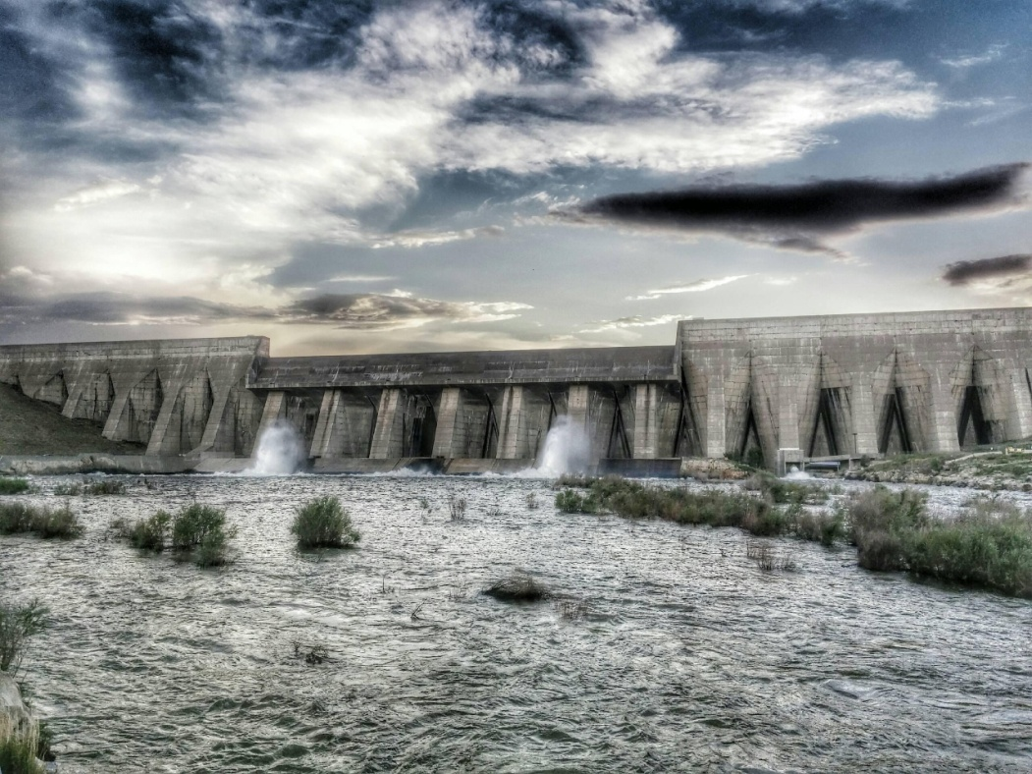
PWWSP “Fall Meeting”
October 16, 2020
  Available Storage
        Above Pueblo
        Below Pueblo
  2020 & 2021 PWWSP Estimate

Slide 8
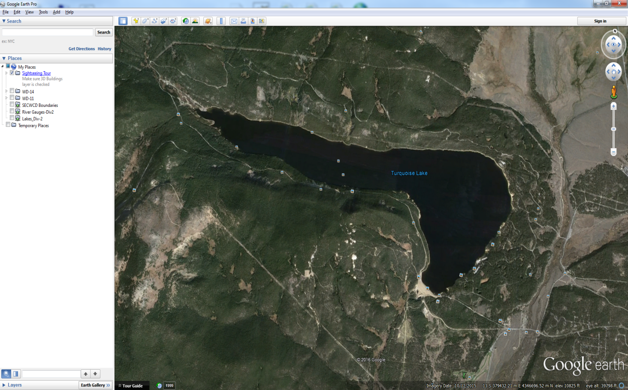
Turquoise Reservoir
Total Storage Around Nov. 14th
  111,398 Af (2014)
  114,986 Af (2015)
  113,006 Af (2016)
  107,919 Af (2017)
  99,443 Af (2018)
  122,628 Af (2019)
  93,639 (10/13/2020)
Total capacity:
  129,440 Ac/Ft

Slide 9
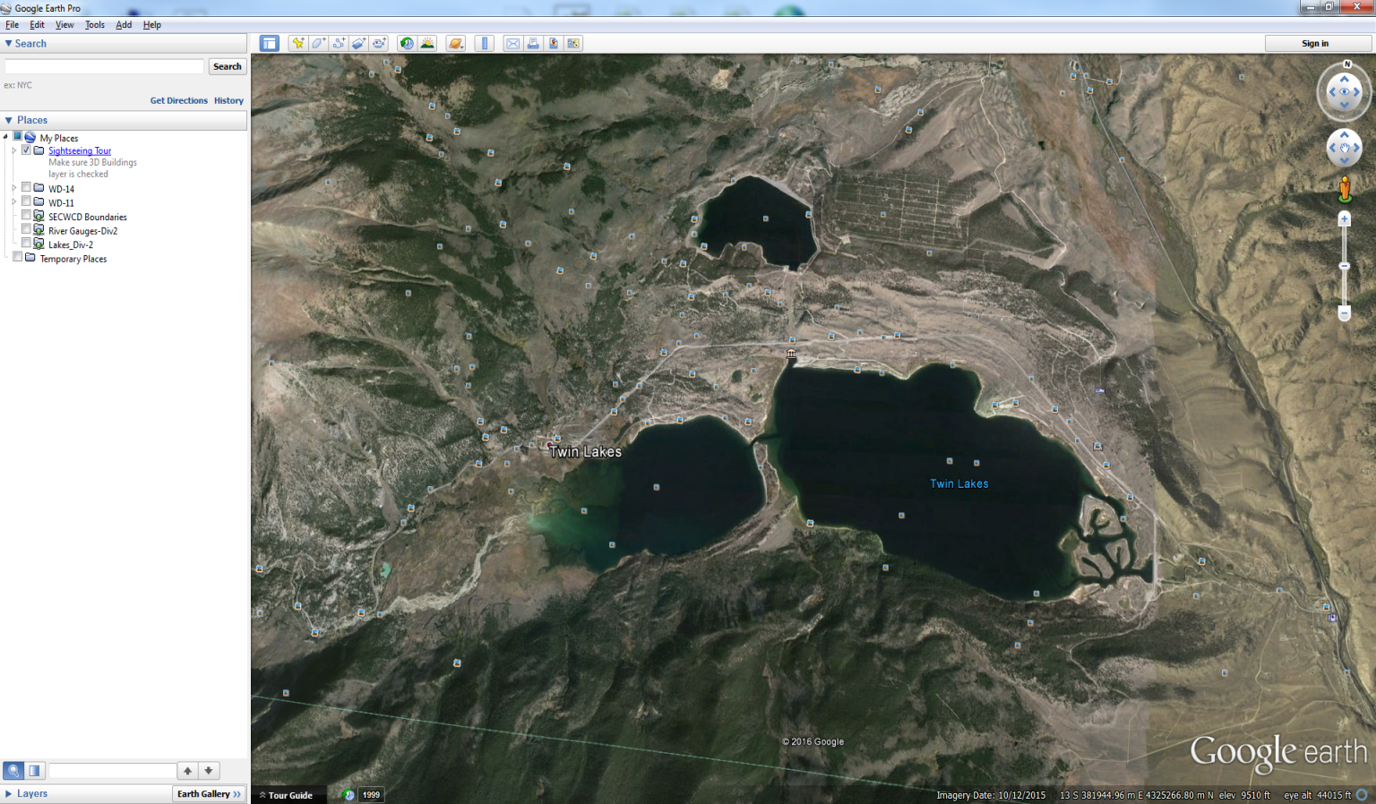
Twin Lakes Reservoir
Total Storage Around Nov. 14th
  121,535 Af (2014)
  113,416 Af (2015)
  104,596 Af (2016)
  114,779 Af (2017)
  97,756 Af(2018)
  125,031 Af (2019)
  103,022 (10/13/2020)
Total capacity:
  141,000 Ac/Ft

Slide 10
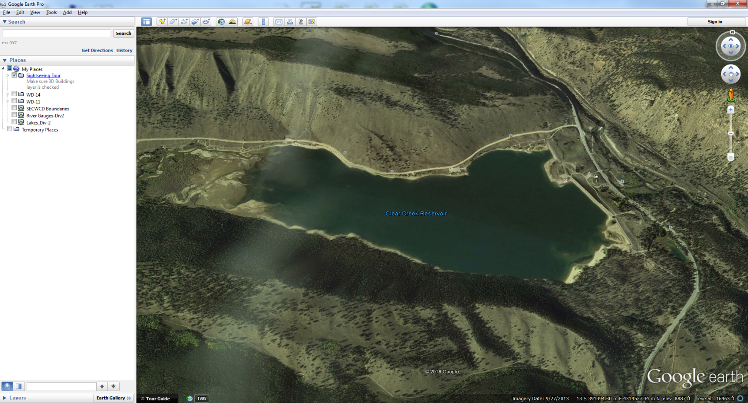
Clear Creek Reservoir
Total Storage Around Nov. 14th
  6,227 Af (2014)
  6,102 Af (2015)
  6,063 Af (2016)
  5,863 Af (2017)
  5,801 Af (2018)
  6,254 Af (2019)
  4,553 (10/13/2020)
Total capacity:
  9,213 Ac/Ft

Slide 11
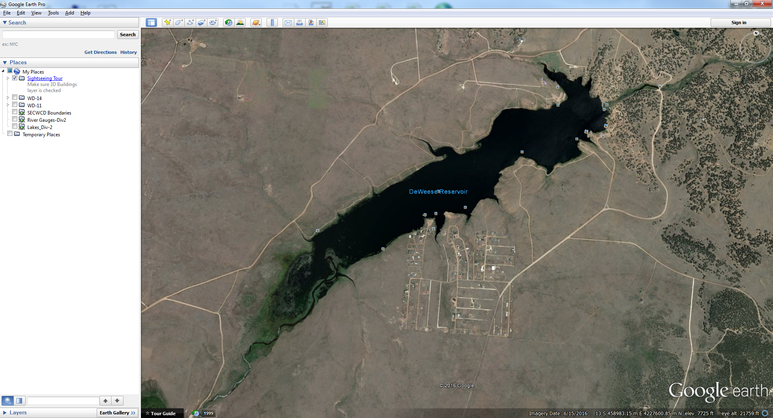
DeWeese Reservoir
Total Storage Around Nov. 14th
  2,210 Af (2014)
  2,843 Af (2015)
  2,183 Af (2016)
  3,499 Af (2017)
  1,080 Af(2018)
  1,929 Af (2019)
  1,395 (10/13/2020)
Total capacity:
  4,338 Ac/Ft

Slide 12
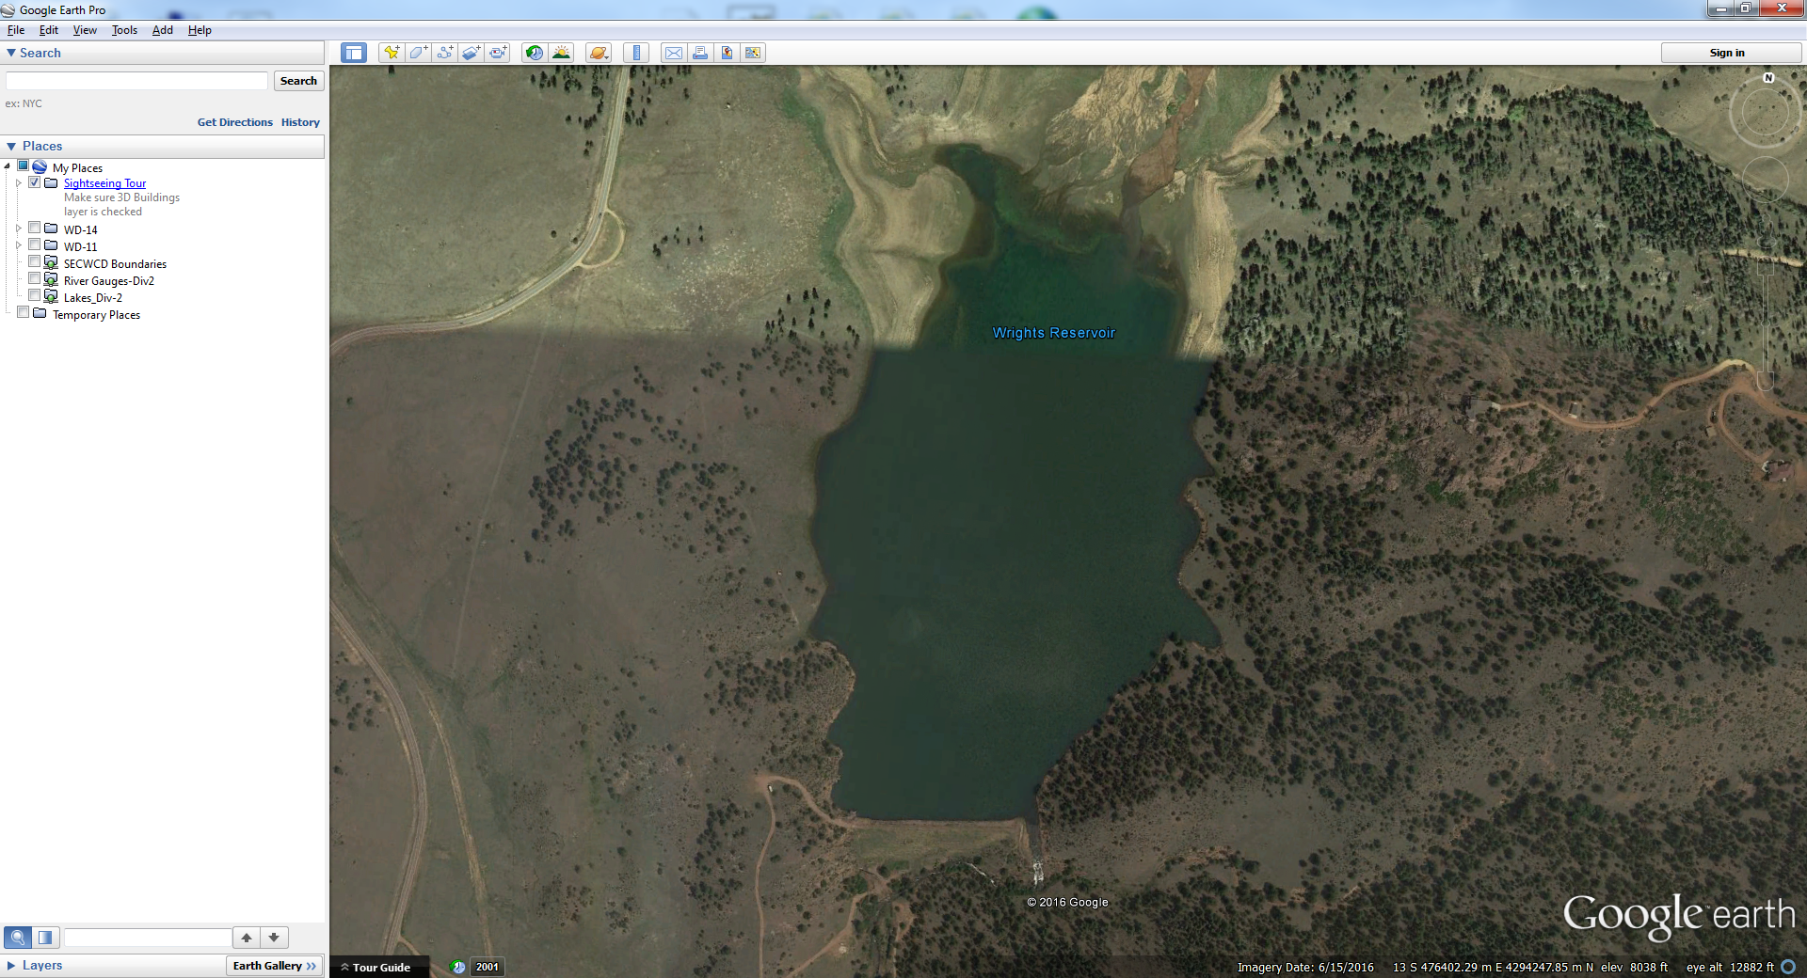
Pisgah Reservoir
Total Storage Around Nov. 14th
  709 Af (2014)
  2,192 Af (2015)
  1,675 Af (2016)
  1,801 Af (2017)
  1,243 Af (2018)
  1,319 Af (2019)
  1,121 (10/13/2020)
Total capacity:
  2,192 Ac/Ft

Slide 13
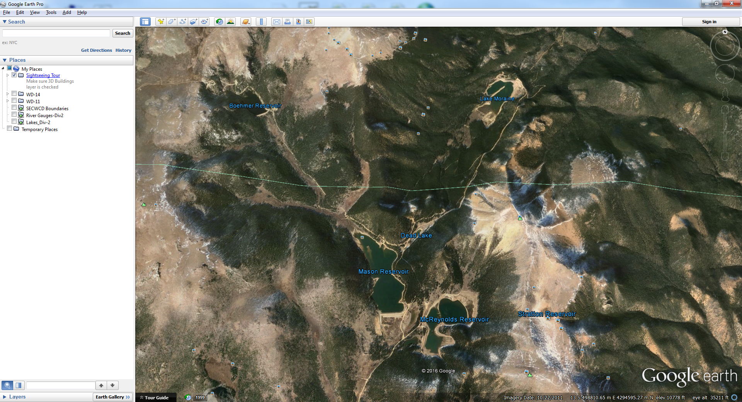
South Slope Reservoirs
Total Storage Around Nov. 14th
  5,382 Af (2014)
  5,342 Af (2015)
  2,719 Af (2016)
  2,782 Af (2017)
  2,700 Af (2018)
  4,570 Af (2019)
  3,668 (10/13/2020)
Total capacity:
  5,416Ac/Ft

Slide 14
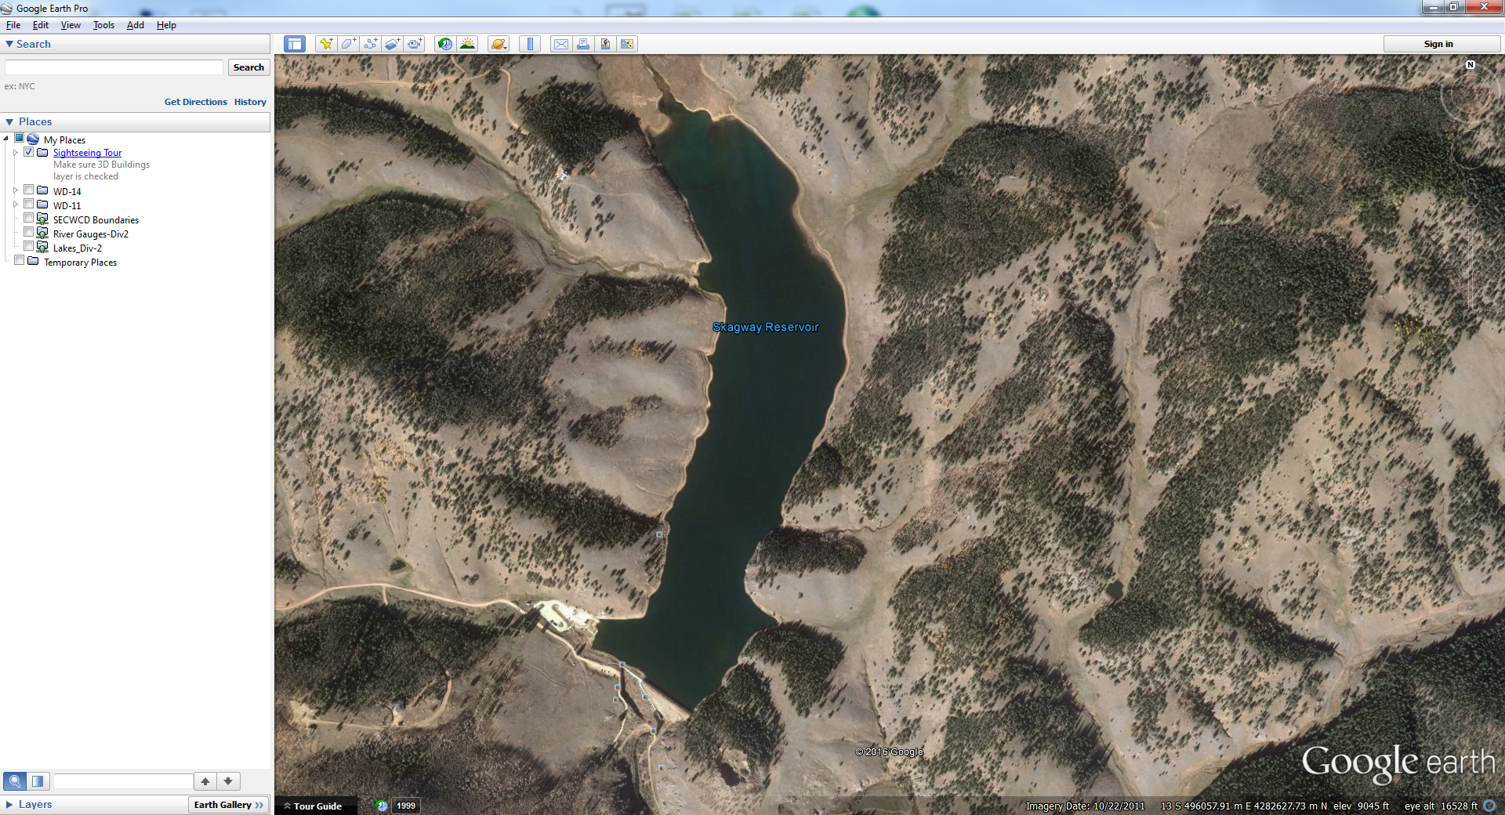
Skagway Reservoir
Total Storage Around Nov. 14th
  1,744 Af (2014)
  1,915 Af (2015)
  1,808 Af (2016)
  2,074 Af (2017)
  1,854 Af (2018)
  1,659 Af (2019)
  1,758 (10/13/2020)
Total capacity:
  2,066 Ac/Ft

Slide 15
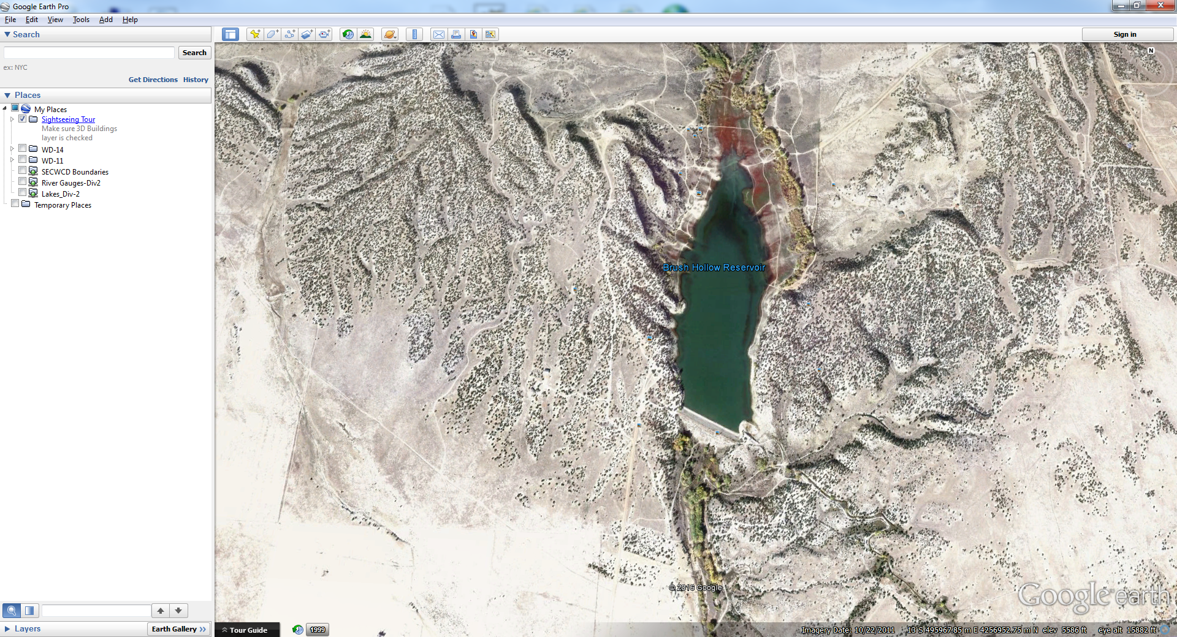
Brush Hollow Reservoir
Total Storage Around Nov. 14th
  805 Af (2014)
  2,263 Af (2015)
  1,??? Af (2016)
  3,399 Af (2017)
  1,859 Af (2018)
  1,092 Af (2019)
  990 (10/13/2020)
Total capacity:
  3,933 Ac/Ft

Slide 16
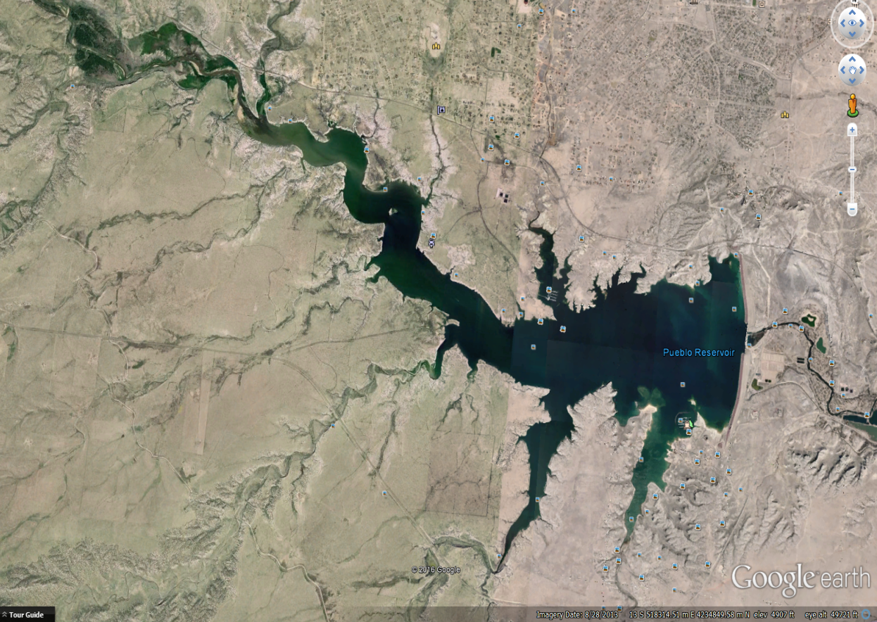
Pueblo Reservoir
Total Storage Around Nov. 14th
  171,493 Af (2014)
  182,949 Af (2015)
  182,229 Af (2016)
  206,187 Af (2017)
  186,210 Af (2018)
  190,959 Af (2019)
  178,192 Af (10/13/2020)
Total capacity:
  311,384 Ac/Ft including the Joint Use Pool
  245,373 Ac/Ft Not including the Joint Use Pool
  Estimated 37,587 Ac/Ft of PWWSP Water on March 15, 2020
  2,955 Ac/Ft Carry-Over (2,955+37,587=40,542)

Slide 17
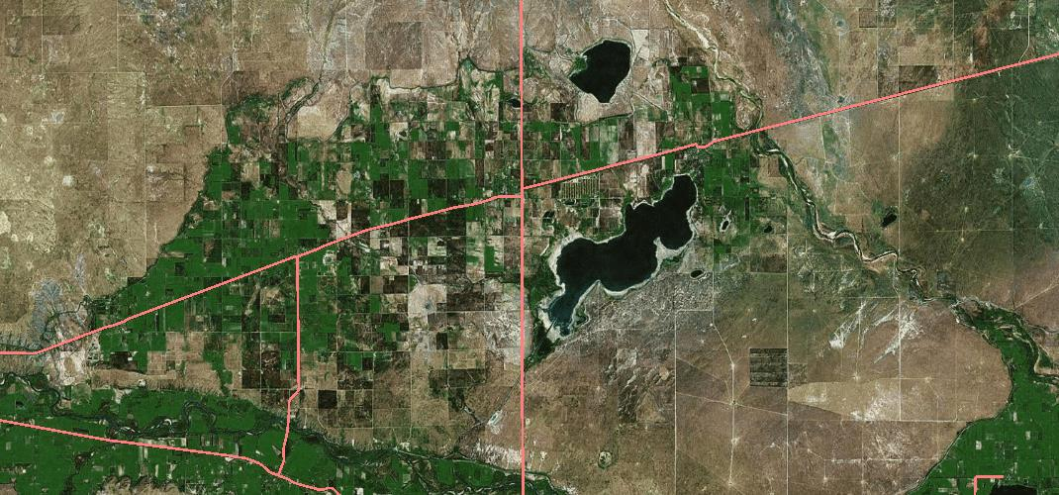
Colorado Canal System
Total Storage Around Nov. 14th
  27,429 Af (2014)
  32,525 Af (2015)
  29,371 Af (2016)
  50,068 Af (2017)
  22,362 Af (2018)
  32,243 Af (2019)
  14,775 (10/13/2020)
Total capacity:
  52,517 Ac/Ft

Slide 18
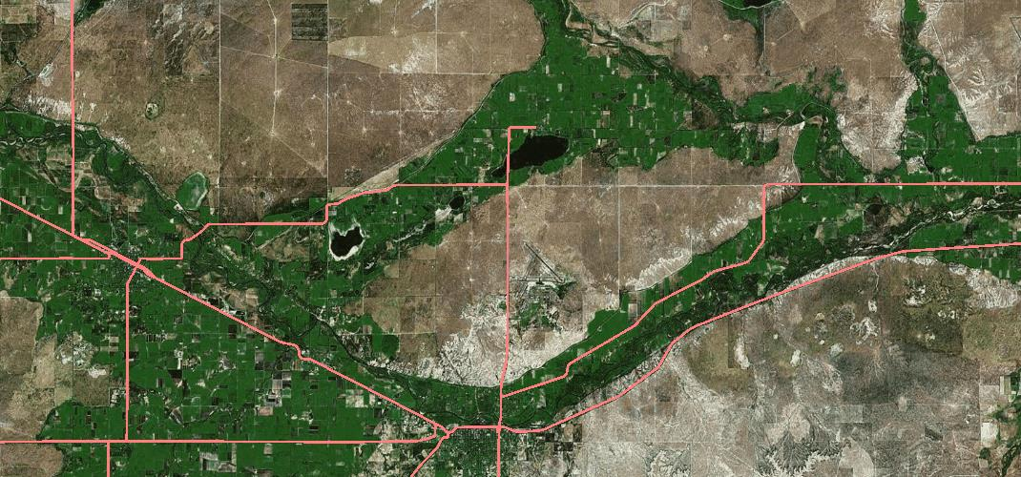
Holbrook Canal System
Total Storage Around Nov. 14th
  3,104 Af (2014)
  2,061 Af (2015)
  1,663 Af (2016)
  4,009 Af (2017)
  366 Af (2018)
  3,409 Af (2019)
  13 (10/13/2020)
Total capacity:
  9,700 Ac/Ft
Dye Reservoir
Holbrook Reservoir

Slide 19
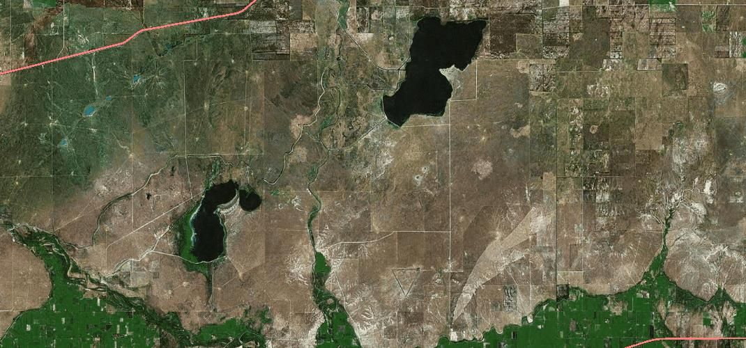
Fort Lyon Canal System
Total Storage Around Nov. 14th
  6,930 Af (2014)
  38,564 Af (2015)
  48,279 Af (2016)
  64,219 Af (2017)
  5,728 Af (2018)
  12,180 (2019)
  8,938 (10/13/2020)
Total capacity:
  78,720 Ac/Ft
Adobe Reservoir
Horse Creek Reservoir

Slide 20
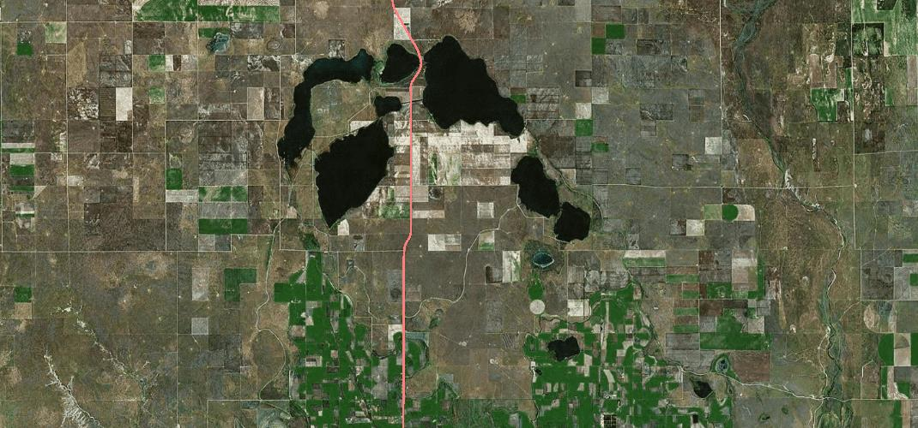
Great Plains System
Neesopah
Neenoshe
Total Storage Around Nov. 14th
  0 Af (2014)
  7,902 Af (2015)
  6,855 Af (2016)
  34,000 Af (2017)
  0 Af Active Pool (2018)
  0 Active Pool (2019)
  0 (10/132020)
Total capacity:
  256,000 Ac/Ft
Nee Gronda
Neeskah (Queen)

Slide 21
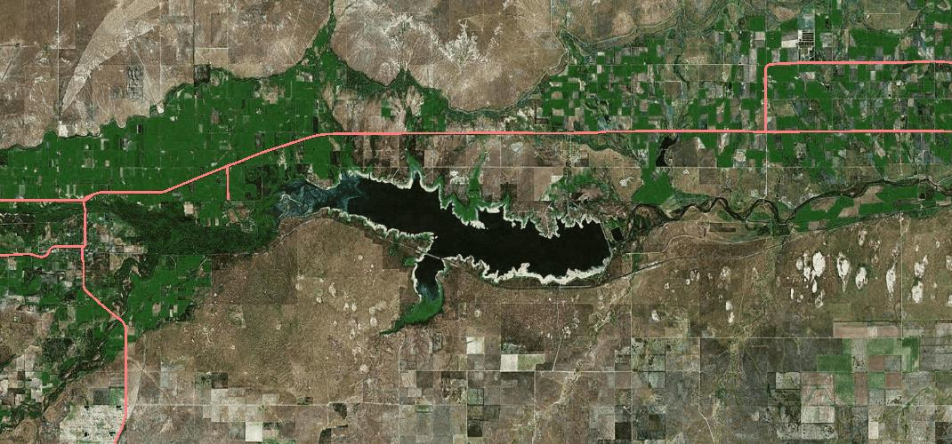
John Martin Reservoir
Total Storage Around Nov. 14th
  9,167 Af (2014)
  209,072 Af (2015)
  102,273 Af (2016)
  251,447 Af (2017)
  133,524 Af (2018)
  72,147Af (2019)
  34,447 (10/13/2020)
Total capacity:
  340,703 Ac/Ft
    Only 75,000 for PWWSP water.
  Including Permanent pool

Slide 22


Slide 23
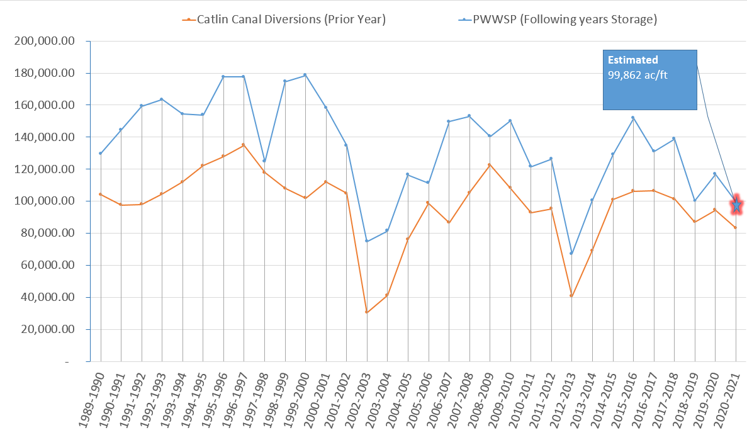

Slide 24
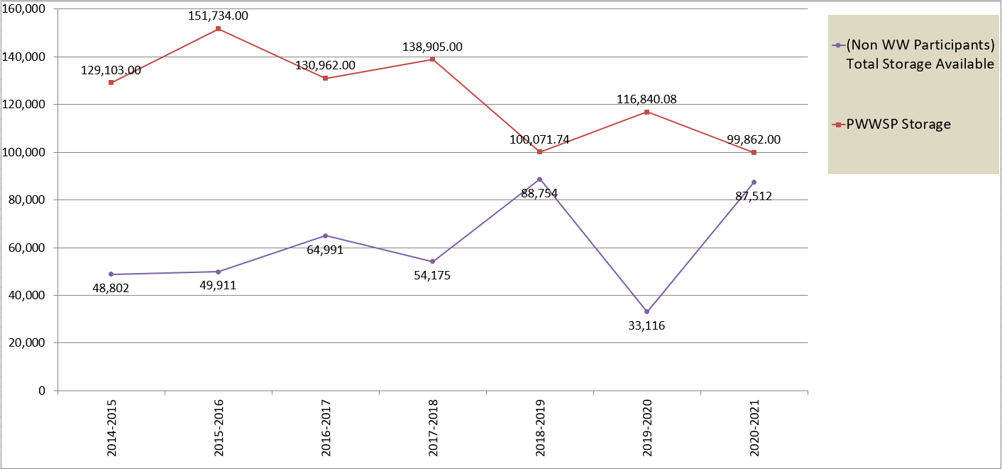
How upstream available storage relates to PWWSP
Estimated PWWSP Storage amount

Slide 25
Predictions for 2021 PWWSP
Van Oort’s: 99,862 Ac/Ft
Tyner’s: 75,000 Ac/Ft
Phil Reynolds: 70,000 Ac/Ft

Slide 26

November 15th @ 00:00
End of Irrigation Season!!!!
All PWWSP Participants Close Their Headgates
Begin Winter Storage
  Pueblo Reservoir reduced to 80 cfs
    (100 cfs w\ Fish Hatchery)
  Fort Lyon Storage Canal Sweeps River

Slide 27


Slide 28
FYI
DWR is starting pond enforcement this fall.
DWR will be looking at the distance from the point of diversion to measuring device this next irrigation season.

